Slide 1

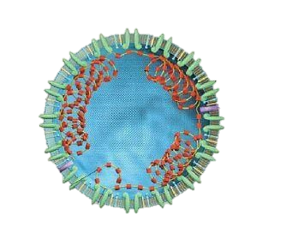



Data Analysis of COVID-19
By Vahid Norouzi, Andrew Lim, Lier Xia

Slide 2

Agenda
● Overview
● Analysis of number of cases and death
● Analysis of cases during Christmas and new year period
● Analysis of number of cases for vaccinated population

Slide 3
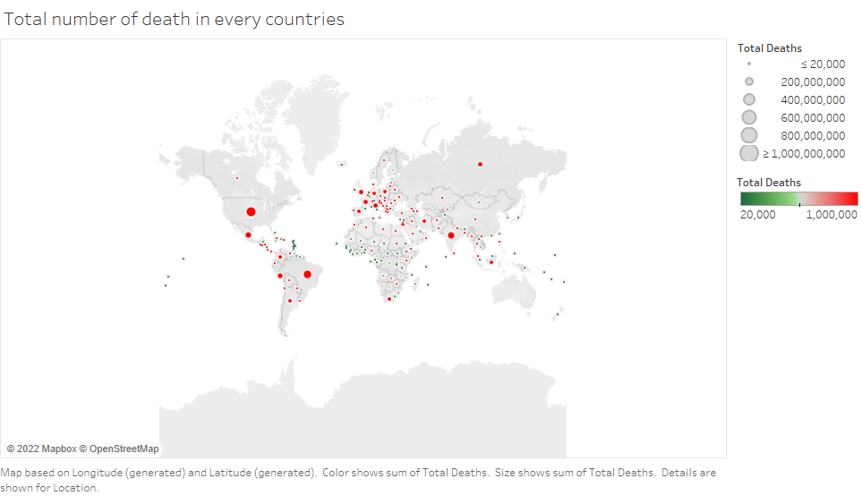
Overview
Notes:
This slide show shows the total number of death in every countries in 2020 and 2021. Those countries which are indicated by red and bigger dots are considered as the higher number of death and those countries with green dots and smaller dots are the counties with lower number of deaths. As you can see United States, India, Brazil and Russia have the highest number of death in 2020 and 2021.

Slide 4
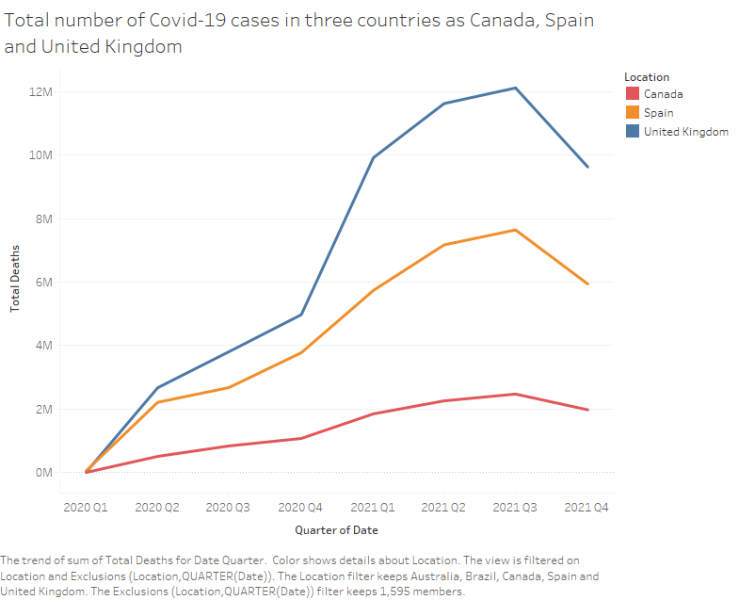
Analysis of number of cases and death
Notes:
In this slide we analyzed the possible trend of the total number of cases in three countries as Canada, Spain and United Kingdom and in each season. The statistics shows there is a relation between winter season and total number of cases in the mentioned countries.

Slide 5
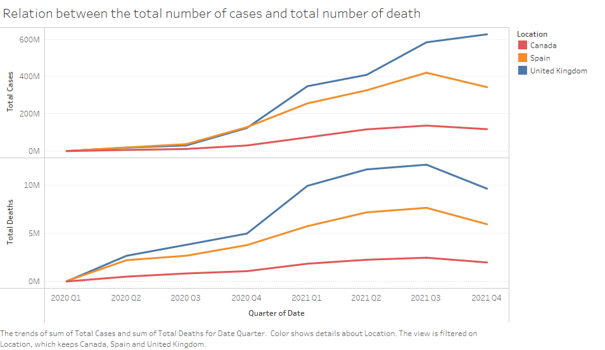
Analysis of number of cases and death
Notes:
After analyzing the trend between the total number of cases and the seasons we started deeper analysis to figure out is there any relation between the total number of cases and total number deaths? As you know the higher number of deaths indicates that the health care systems probable need more staff and higher needed capacity for the hospitals. As you can see in the Fall of 2020 there was a sharp increase in the total number of cases and deaths in all three countries. But, surprisingly, in the Fall of 2021 although there was increase in the total number of cases, the number of death has declined that can be explained by the increase int the number people who are double vaccinated in this season.

Slide 6
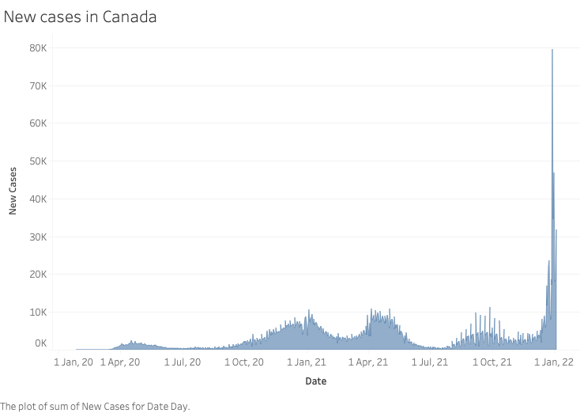
Analysis of cases during Christmas and new year period

Slide 7
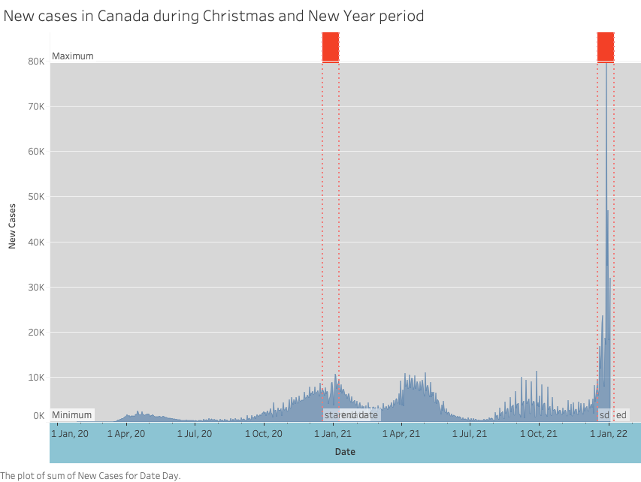
Analysis of cases during Christmas and new year period

Slide 8
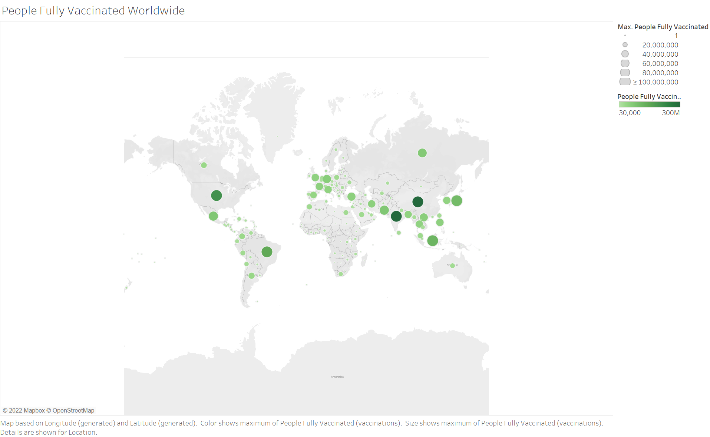
Analysis of number of cases for vaccinated population
Notes:
This slide show shows the total number people fully vaccinated from q1 2020 to q4 2021. Countries are indicated by green for safety ☺ and bigger dots are considered as the higher number of vaccinated people and smaller dots are the countries with lower number of vaccinated people. As you can see most of the developed countries have been doing a good job.

Slide 9
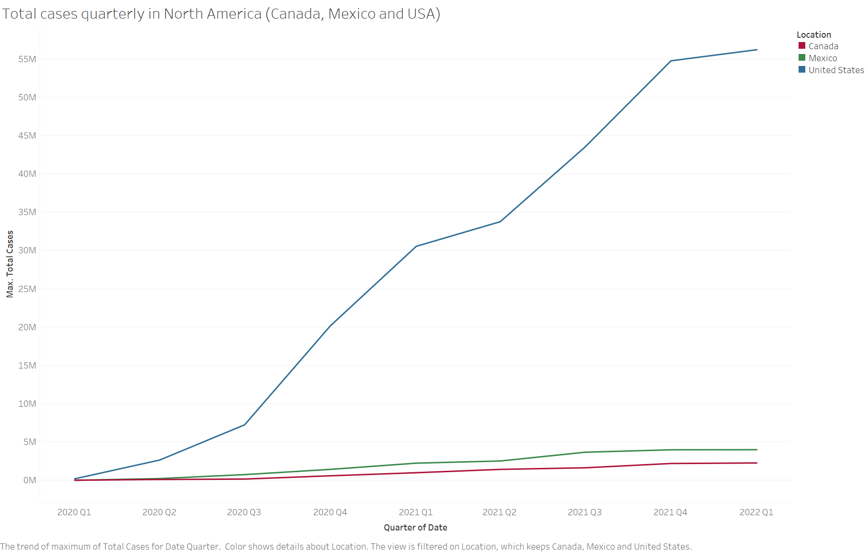
Analysis of number of cases for vaccinated population
Notes:
In this slide we analyzed the possible trend of the total number of cases in North America. The statistics shows there has been continuous increase in cases.
Use cases per capita, use months instead of quarter

Slide 10
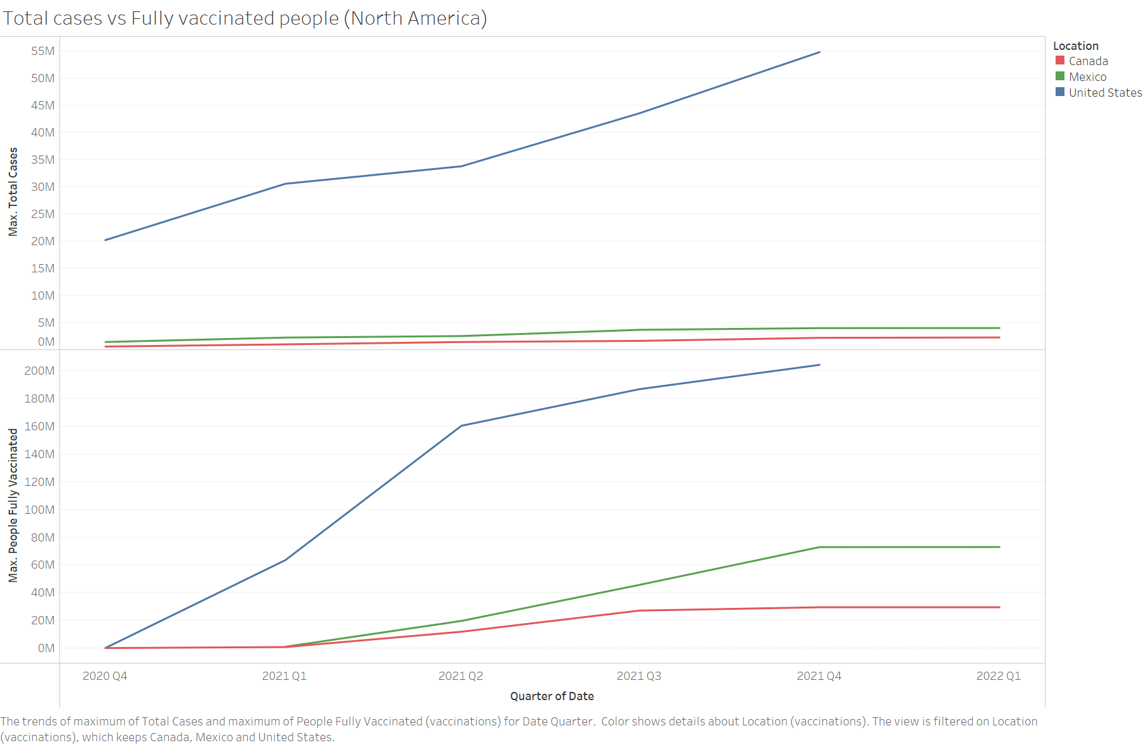
Analysis of number of cases for vaccinated population
Notes:
What we can realize right away by looking, the highly increase with the number people fully vaccinated 2021 q1 – 2021 q2 especially US, we can see the new case number going down. So this means before Delta and Omicron hit, the vaccination worked well on the original virus. However vaccination seems to lose their influence when omicron hit.

Slide 11

Conclusion
The number of staff needed in the Fall increases around 30%
The number of news cases during Christmas and New year is higher than regular days
Vaccination used to be very much effective, but when omicron hit worldwide around q3/q4 2021, cases dramatically increased.

Slide 12
Thank you!

